Slide 1

VITA SA App
Training for Volunteers
Notes:
This is the training materials for vita volunteers on using the app
There is a separate deck for site coordinators

Slide 2
Why an App?
Improve client experience
Reduced wait times
Provide feedback
Improve volunteer experience
Go where they are most needed
Provide suggestions
How:
Focus volunteers on sites that need and can use help
Client: Visibility to sites and support options (MFT, Express, etc.)

Slide 3
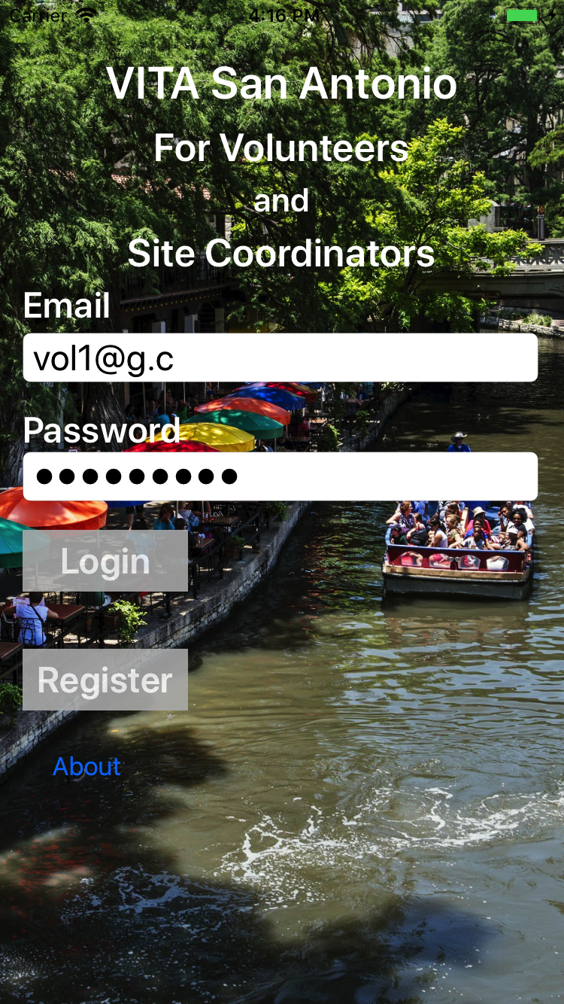
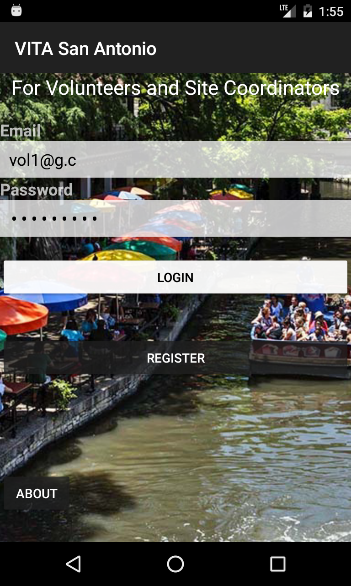
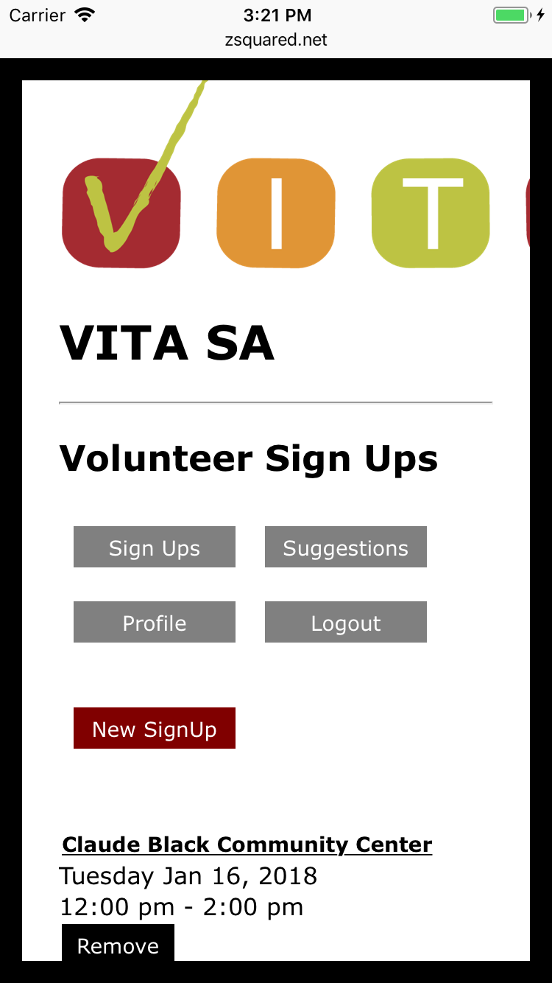
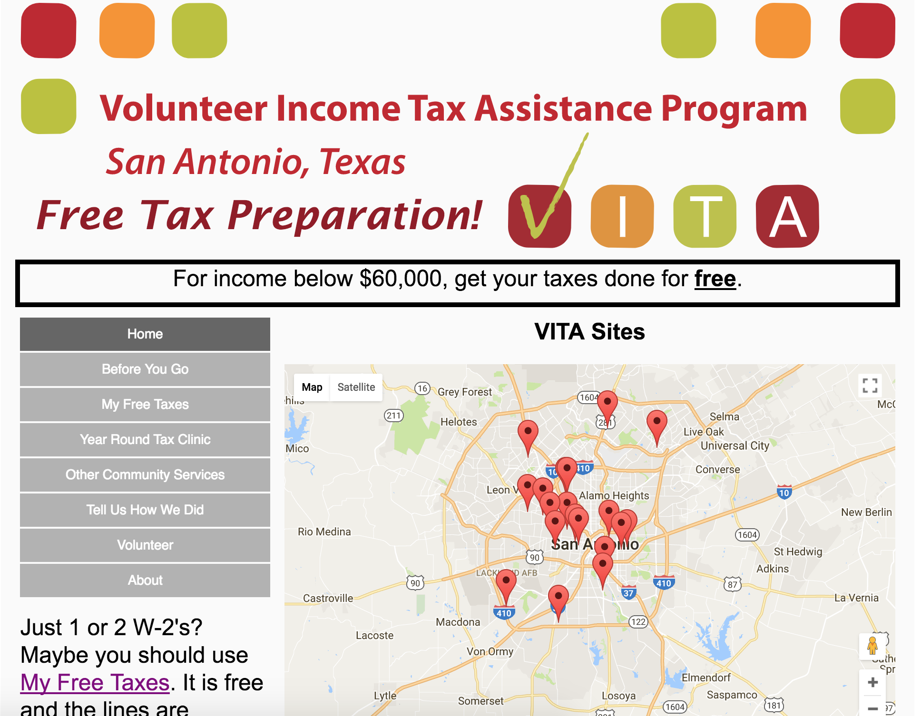
VITA App and Website
Volunteers & Site Coordinators
VITA Clients
(English and Spanish)
iOS
Android
Mobile Web
Browser and mobile devices
Mobile web: http://vitasa.org/vitavol.html

Slide 4
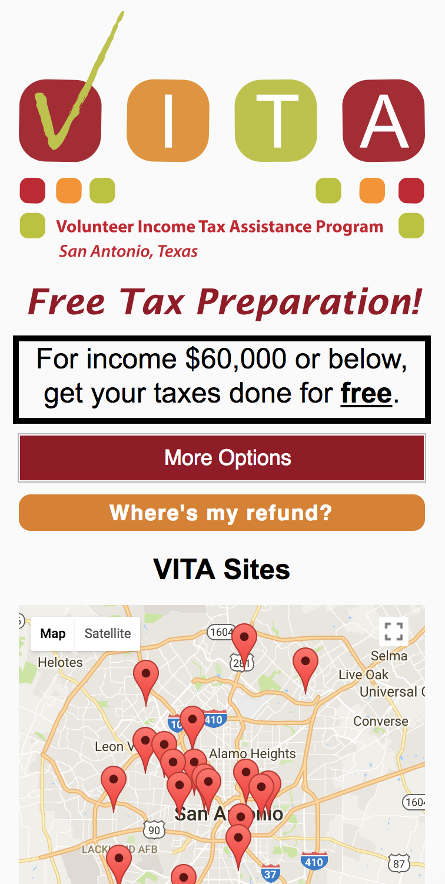
vitasa.org - Clients
Try it out: vitasa.org
Map of sites and guidance on what to bring
Info on VITA
List of VITA sites, address, and services
My Free Taxes: map and instructions
Year Around Tax Clinic: locations and services
Community services: list and services
Client feedback
Contact Us: Alejandra and Sheila
Volunteers: why and how to volunteer
(Spanish and English)

Slide 5
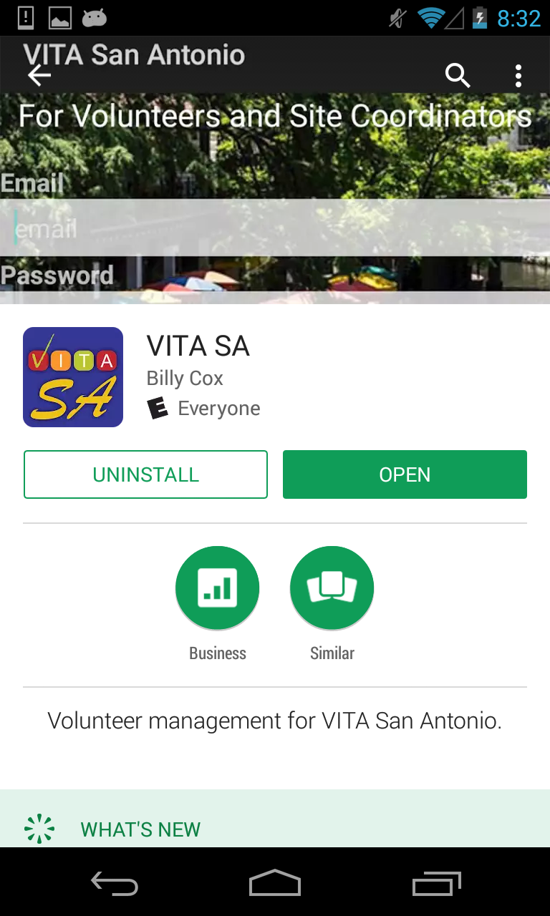

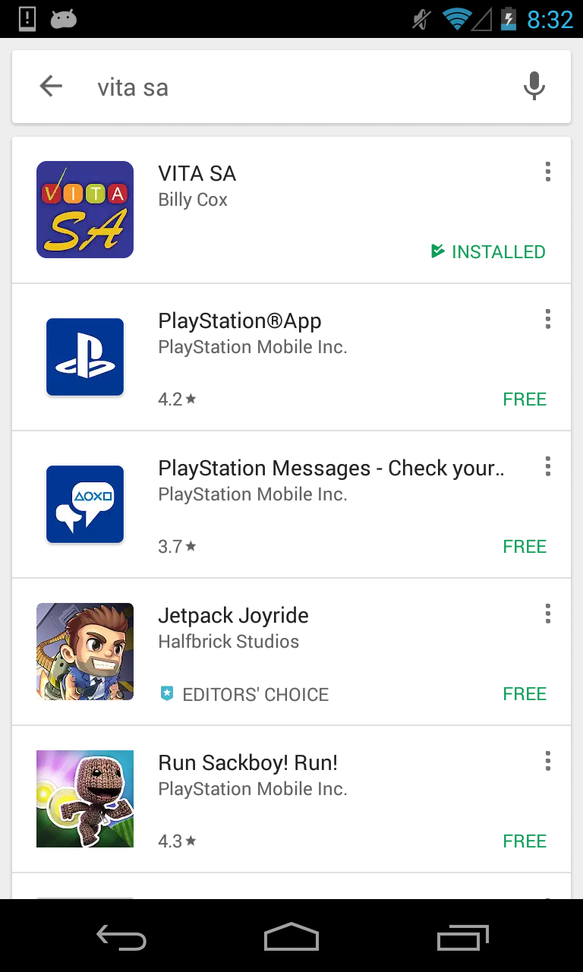
Installation - Google
Open Google Play Store
Search for “vita sa”
Select VITA SA
Then “Install”

Slide 6
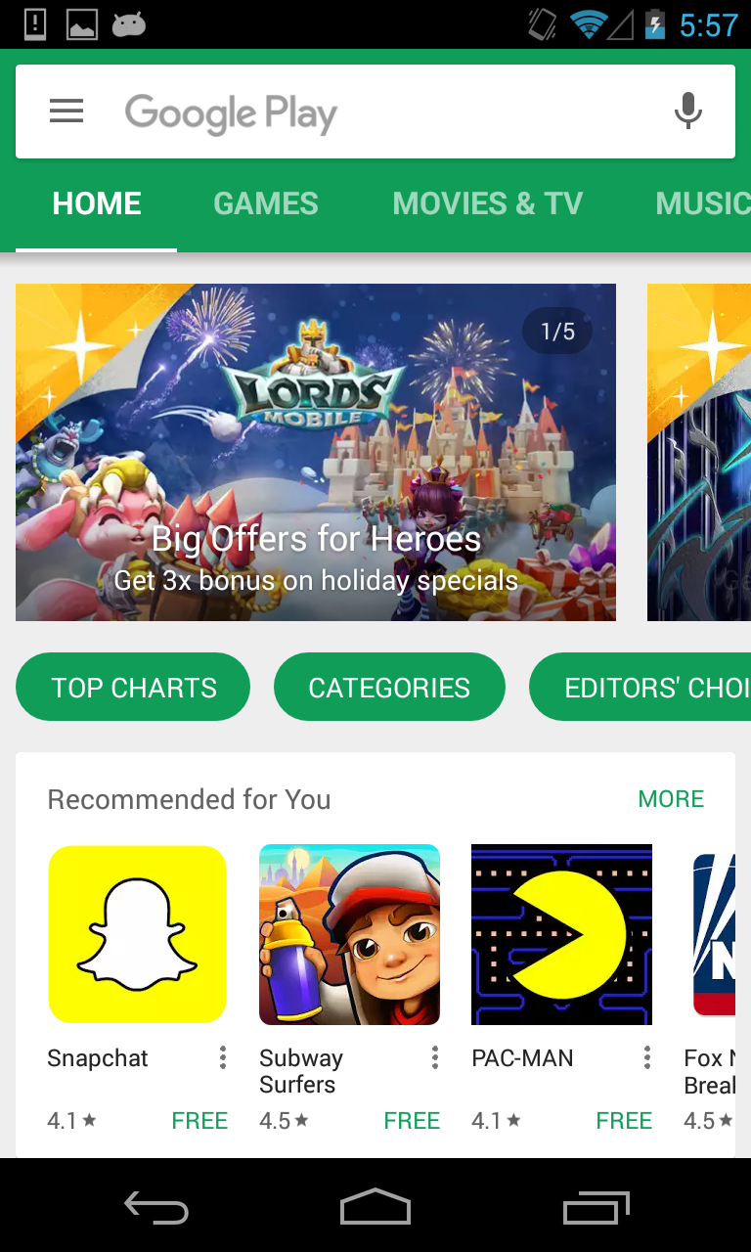
Update - Google
Open Google Play Store
Open Settings

Slide 7
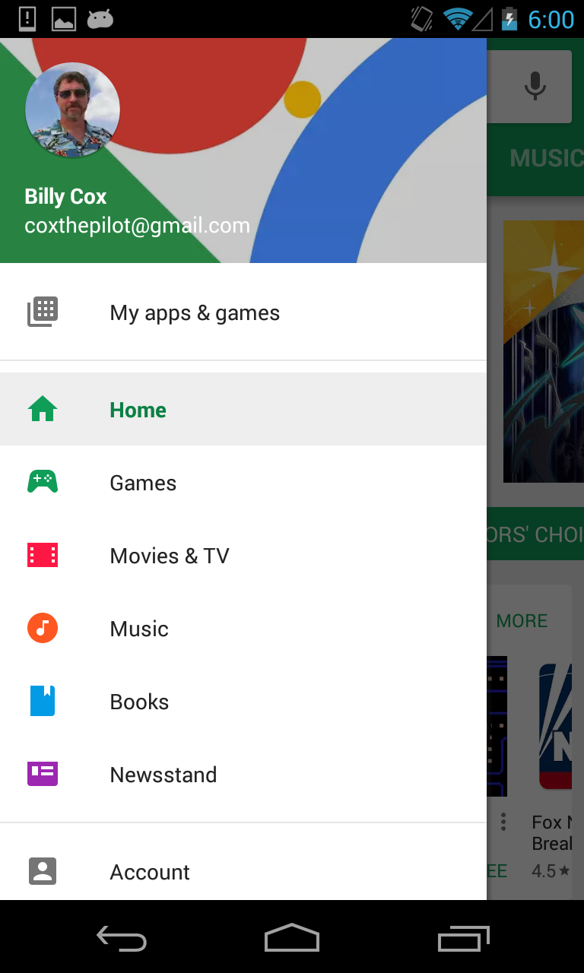
Update - Google
In Google Play -> Settings
Select My apps and games

Slide 8
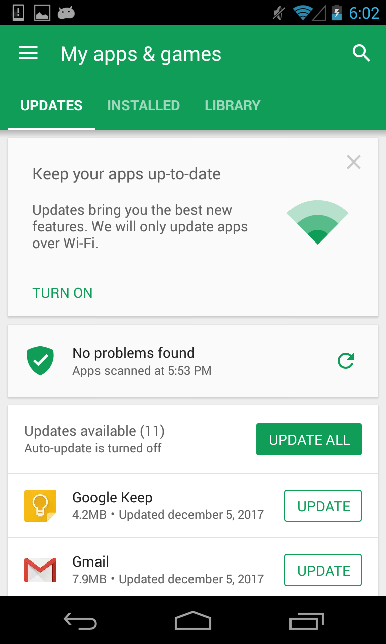
Update - Google
VITA SA app will appear in this list if there is an update waiting to be installed

Slide 9

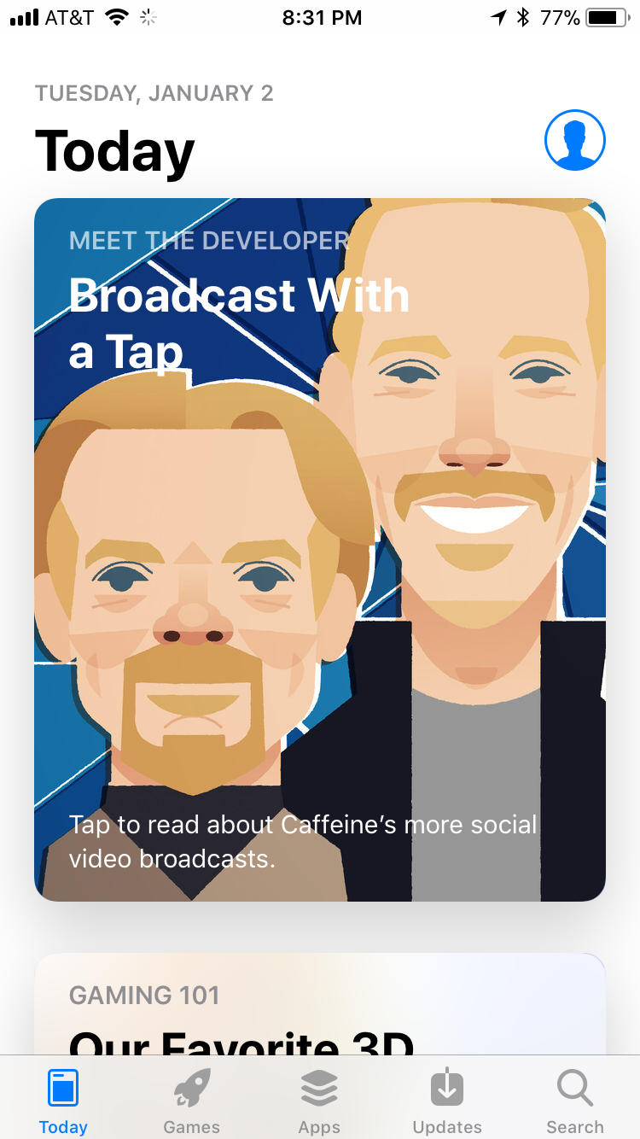
Installation - Apple
Open Apple App Store
Open Search

Slide 10
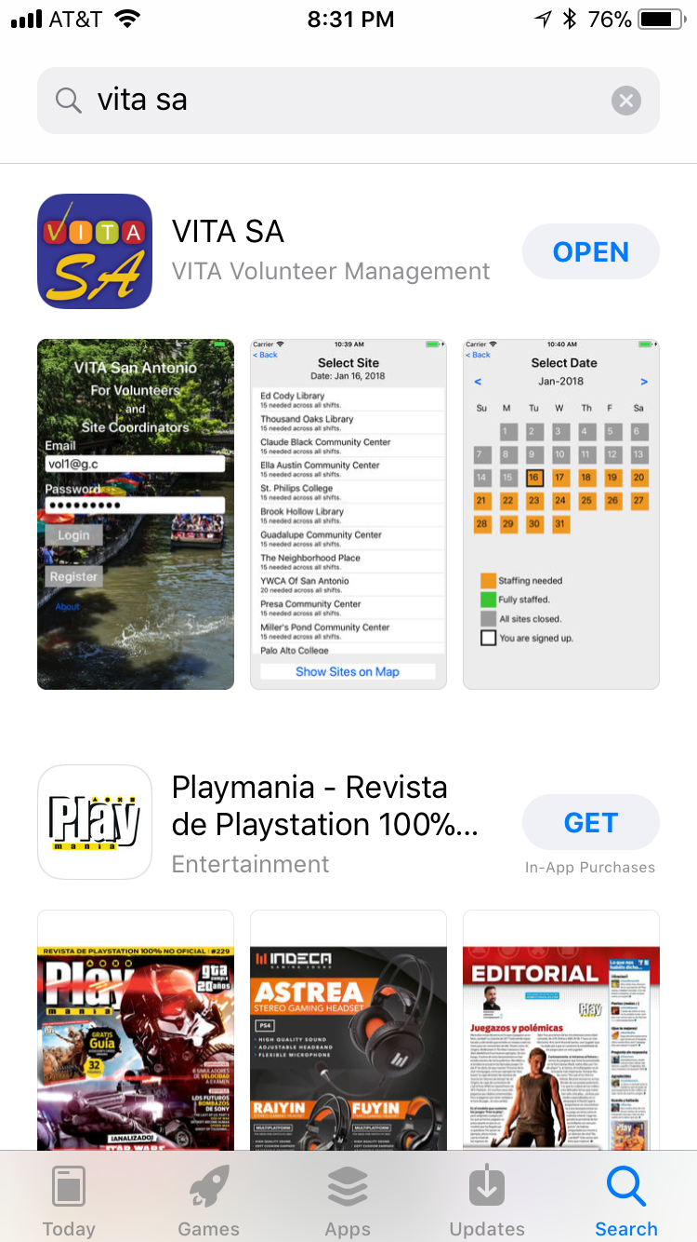
Installation - Apple
Search for “vita sa”
“VITA Volunteer Management”
Touch “Get” (it’s free)

Slide 11
Update- Apple
Open App Store
Touch Updates
VITA SA will appear if an update is available

Slide 12
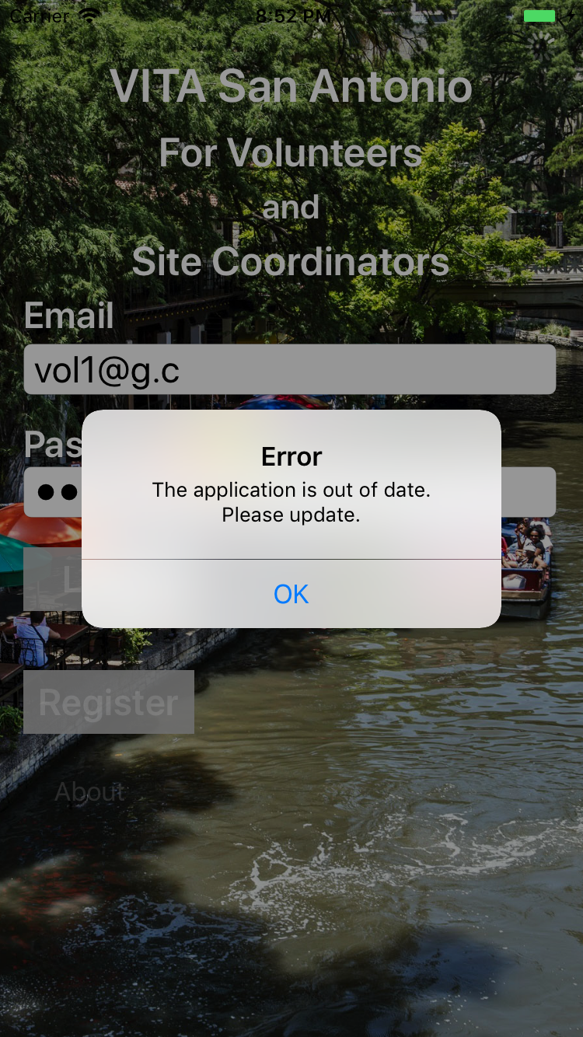
Need for App Update
You will need to update your app to proceed if you see: “The application of out of date. Please update.”

Slide 13
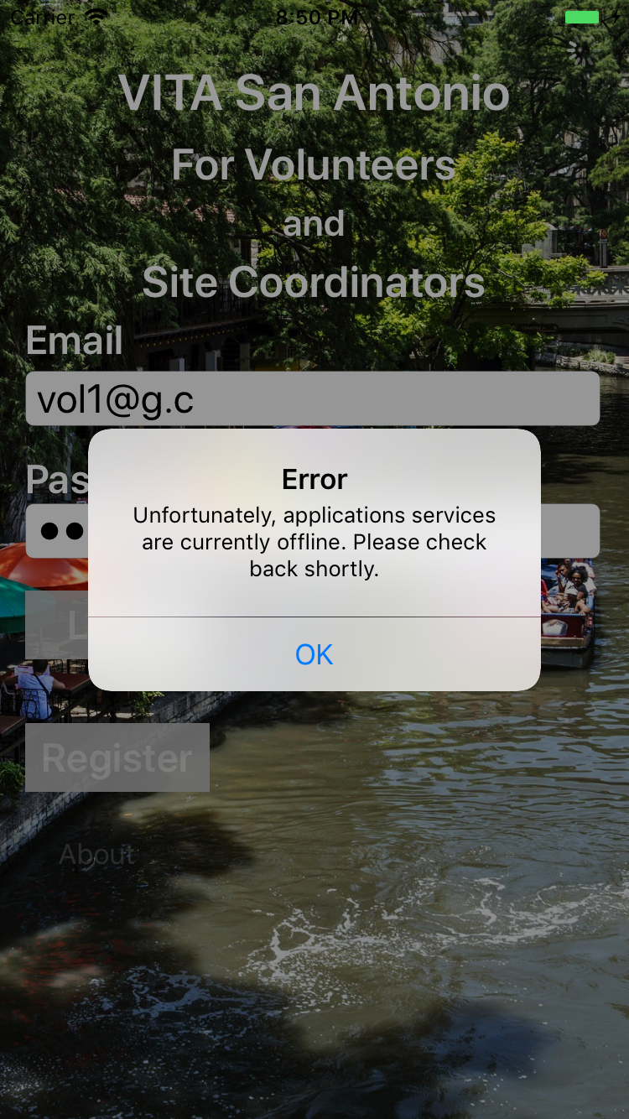
App is temporarily offline
If the app is down for maintenance, you will see this message.
Check back in a few minutes

Slide 14
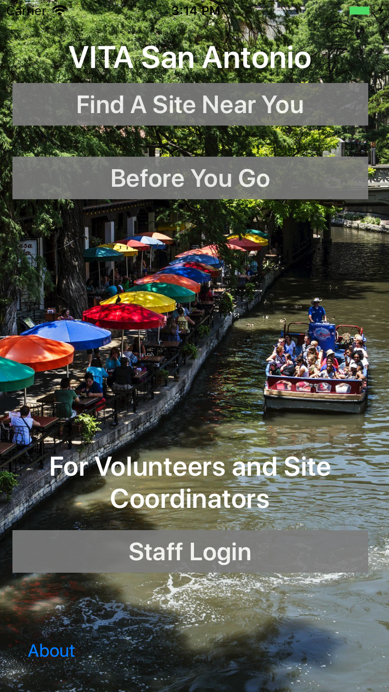
Apple Opening Screen
Basic client information
Push clients to vitasa.org
Use Staff Login

Slide 15
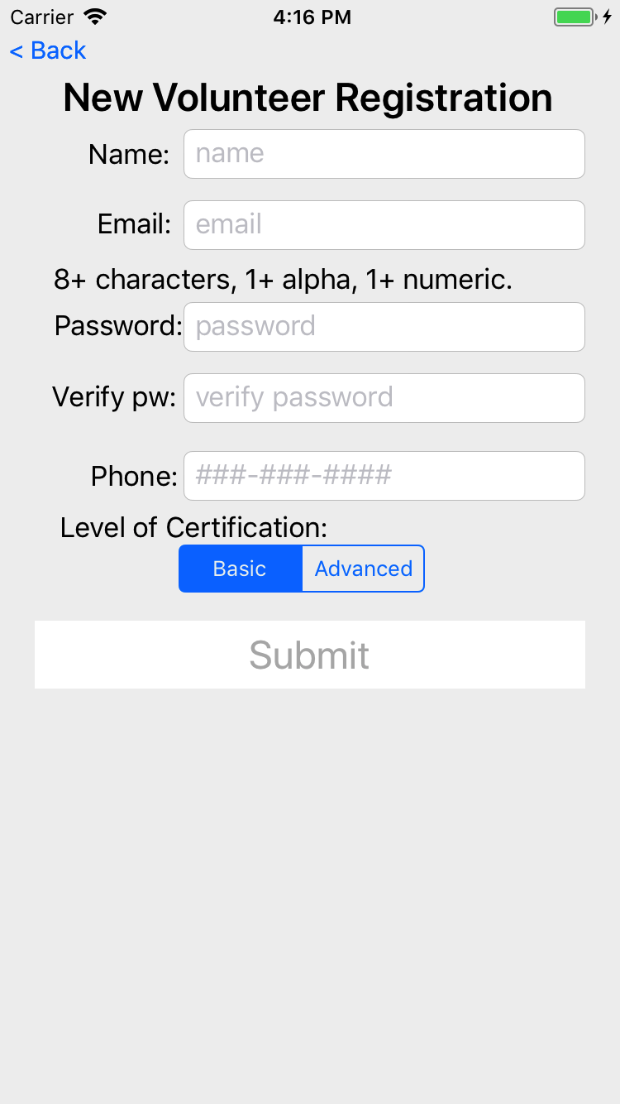
Register
Register
Enter name, email, password, phone, and certification
Make sure you enter the exact same password twice
Press Submit

Slide 16
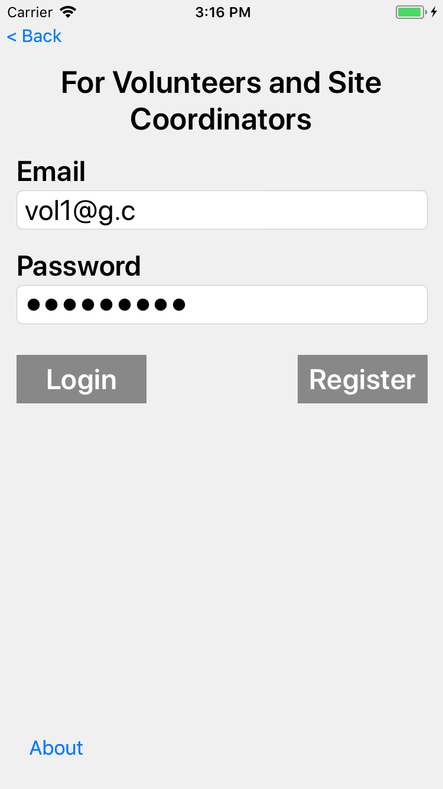
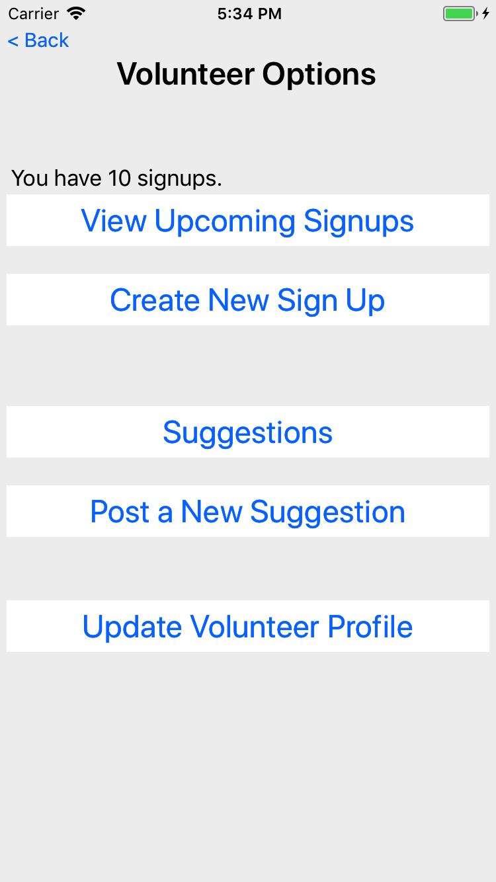
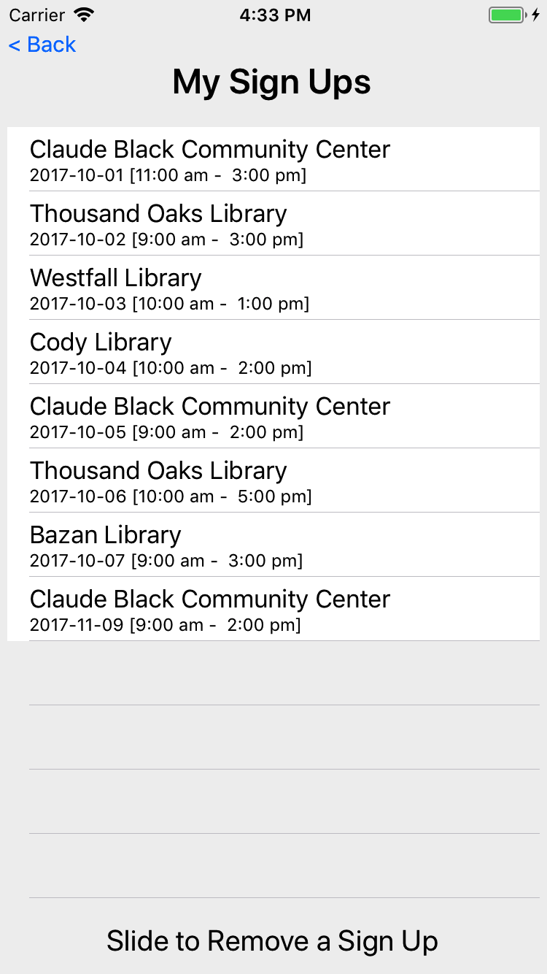
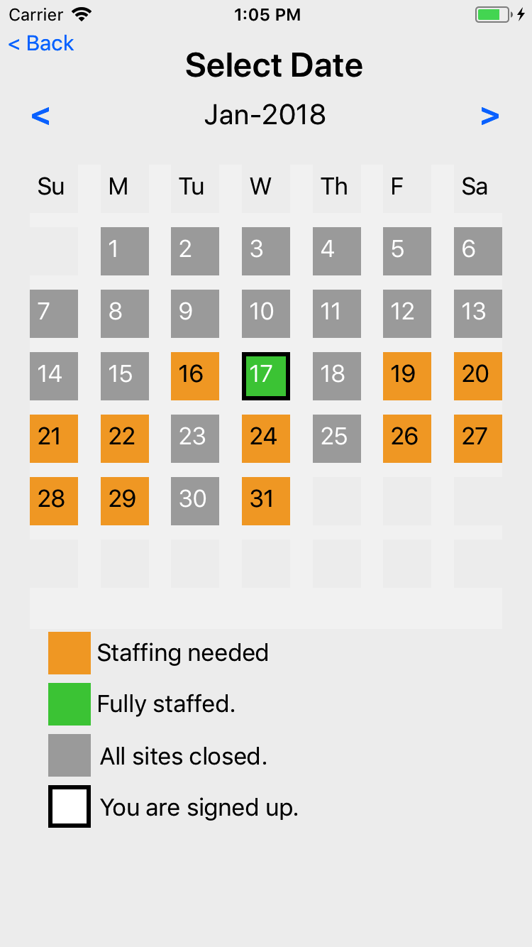
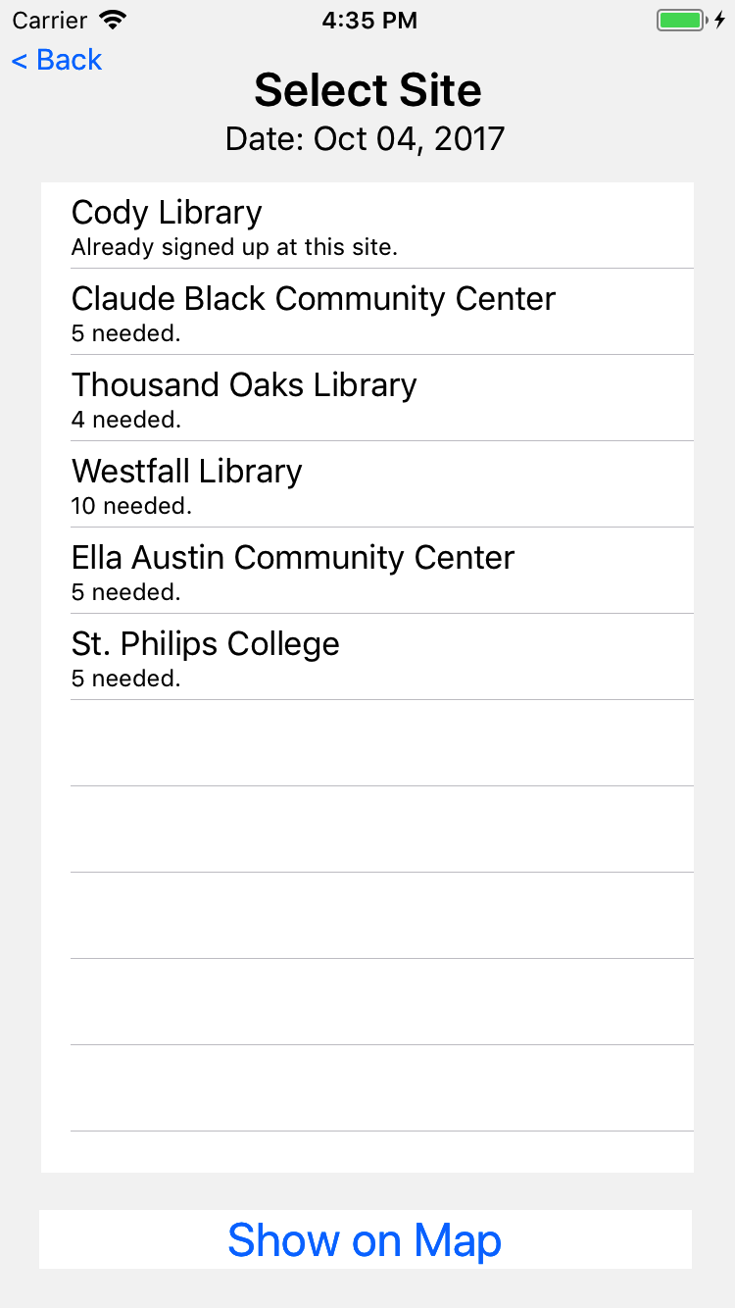
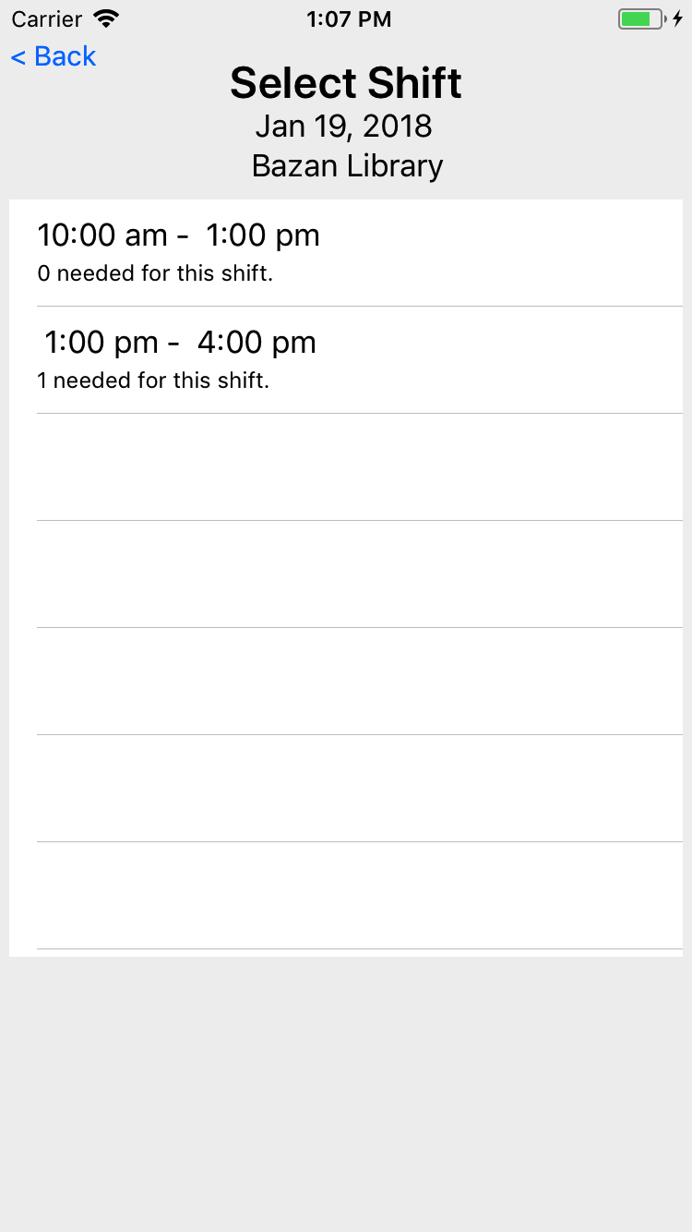
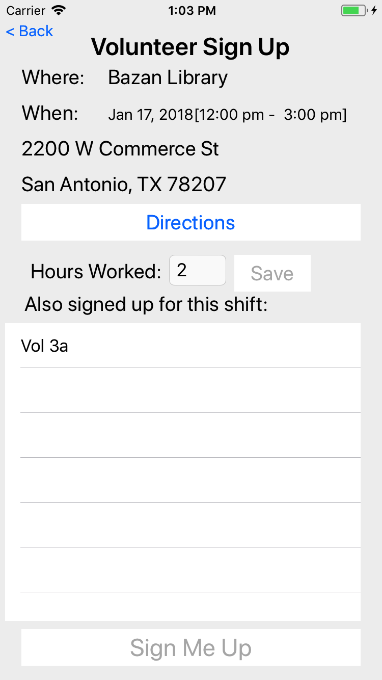
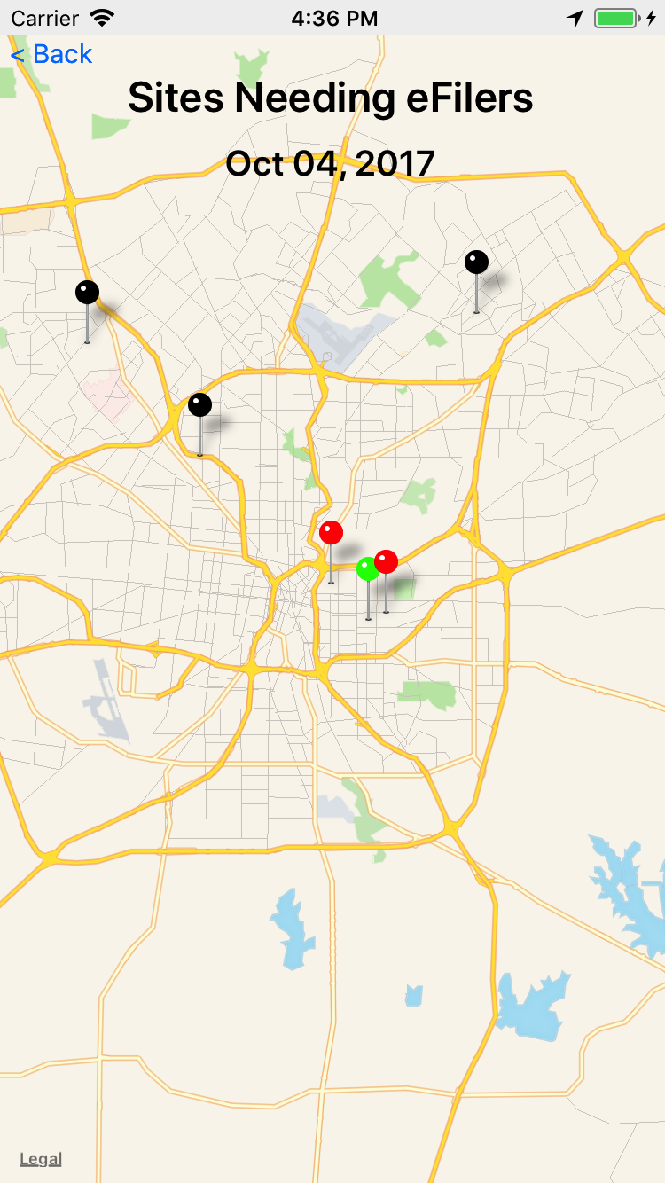
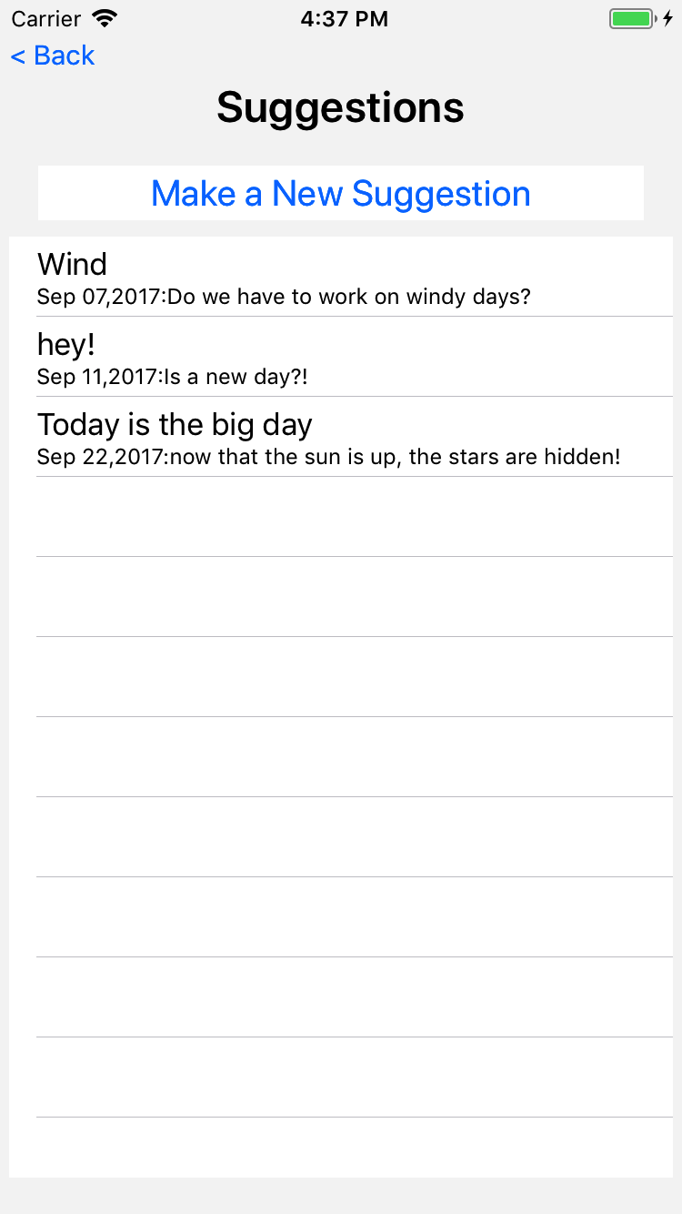
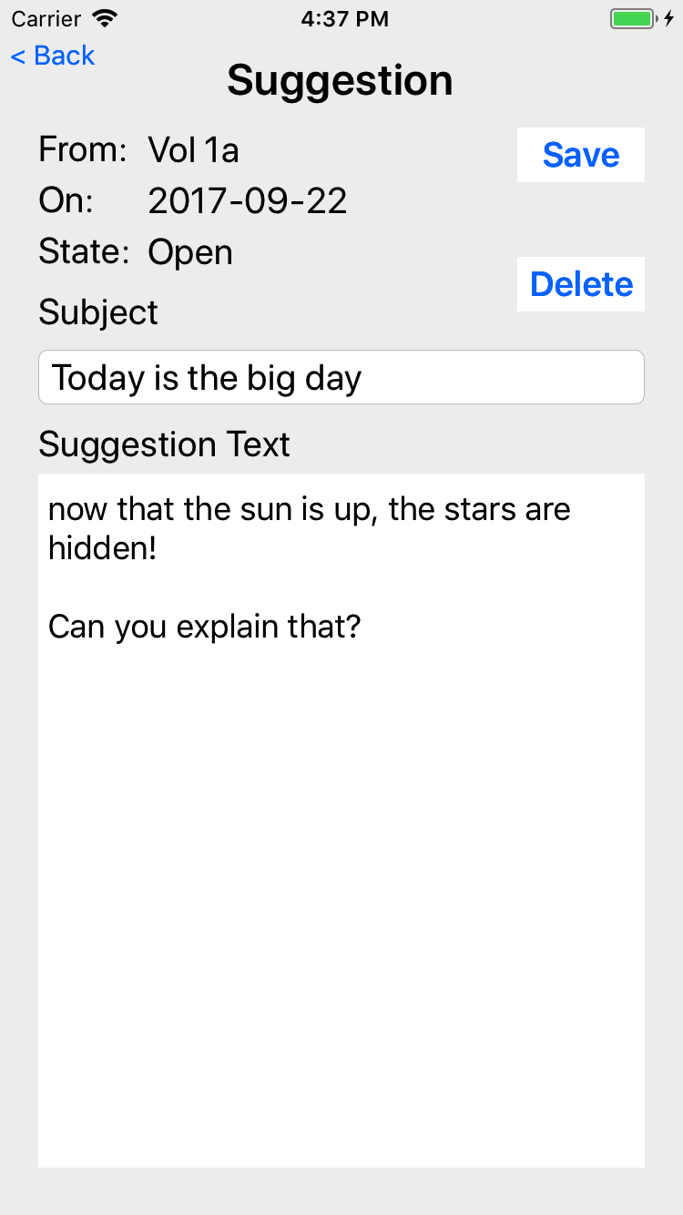
VITA SA App – Volunteers
Signups
Select Date
Select Site
Select Shift
Confirm
Receive notifications from volunteer management office.
Suggestions
Notes:
This is the general flow of the app.
For signups, the volunteer can view current signups, or create a new signup. The calendar view allows you to select the date, then select the site before committing to a signup.
Volunteers can also post suggestions. Suggestions are reviewed by a volunteer review committee which will make recommendations to the leadership team.

Slide 17
Volunteer Actions
New Volunteer Registration
Signup to volunteer at a site on a date
Review current signups
Post a suggestion
Change profile
Notes:
Rather than just review the various screens, we will review how to use the app to do a short list of standard use cases.

Slide 18
New Volunteer Registration
Everyone must register
Back office staff must review, approve, and assign a role (Volunteer)
Name, phone, and level of certification can be changed in Update Profile
Notes:
Everyone must register and be approved for use.
Fill in the required information and submit. Some time later the back office staff will review the registration and approve.

Slide 19
New Signup - Login
Login with credentials from registration
For lost password, contact staff
Notes:
Once registration has been approved, you must login to create a signup.

Slide 20
New Signup
Summary of Volunteer app options
Notes:
This is the primary volunteer navigation screen
Touch Create new sign up to start the process

Slide 21
New Signup – Select Date
Orange square means one or more sites are open and need help
Green means all open sites are fully staffed
Box around the date means you are already signed up for 1 or more sites on that date
Grey if no site is open on that date
Select desired date to volunteer
Notes:
Start by selecting the desired date
Orange squares means one or more sites need help. Green means all open sites are fully staffed. Grey is no open site.
A box around the date means you are already signed up for one or more sites on that date.

Slide 22
New Signup – Select Site
Shows sites that have needs on the selected date
Shows if you are already signed up
Note that mobile teams may be signed up for multiple sites on a single date
Select the desired site
Notes:
Now that the date has been set, select the site.
Details are shown here on where you might already be signed up, or the number of open seats at the various sites.

Slide 23
New Signup – Map View
Same view but on a map
Black is closed on that date
Green is no needs
Red is 1 or more eFiler needed
Select the desired site
Notes:
If you want, you can view the sites on a map

Slide 24
New Signup – Select Shift
Select the shift at the site on that date
Most shifts are 2 hours
Signup for as many shifts as desired
Select the desired shift

Slide 25
New Signup – Review
Can get directions to the site (via google or apple maps)
View others that have signed up for that shift on that site on that date
Select Sign Me Up to commit
Notes:
Once you select a site, you can see site details and other volunteers at that site on that date.
To commit to that site on that date, touch Sign Me Up

Slide 26
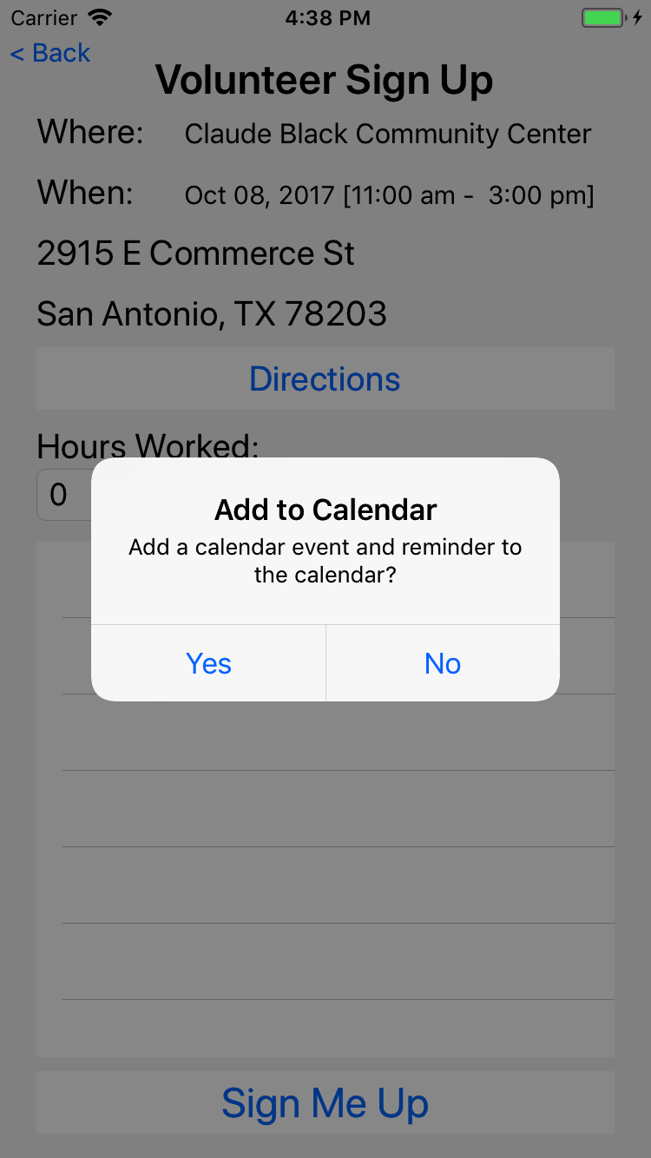
New Signup – Calendar
Option to add to the Calendar
Select Yes to add event to calendar
Notes:
You then have the option to create a calendar event for your calendar, which also creates a reminder

Slide 27
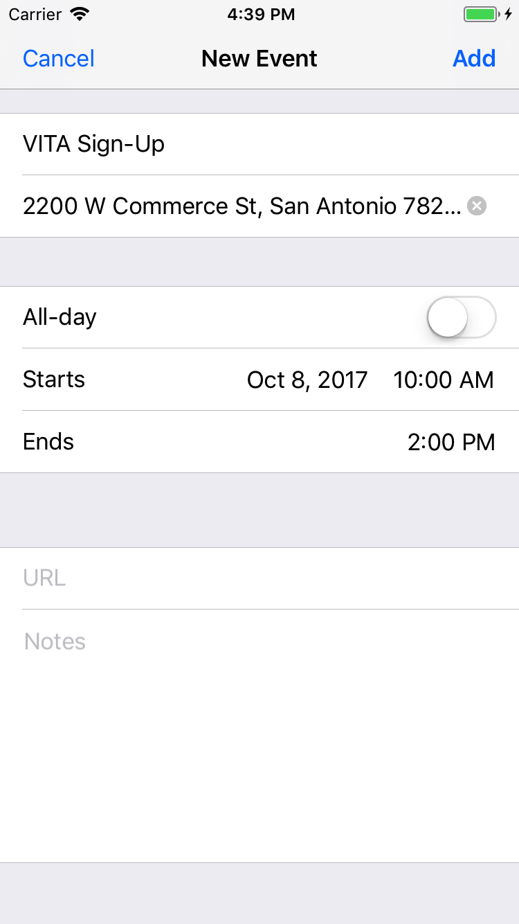
New Signup – Calendar
iOS: Optionally edit the calendar entry
Select Add to add event to calendar
Notes:
For iOS, you can edit the calendar item before committing to the calendar
Congrats, a new signup has been created.

Slide 28
Review Signups
Notes:
And select view signups.

Slide 29
Review Signups - List
Lists signups for today and going forward
Historical signups are only visible to the site coordinator
Select Signup to view
Notes:
A list of signups is presented. Touching a signup allows you to see the details for that site

Slide 30
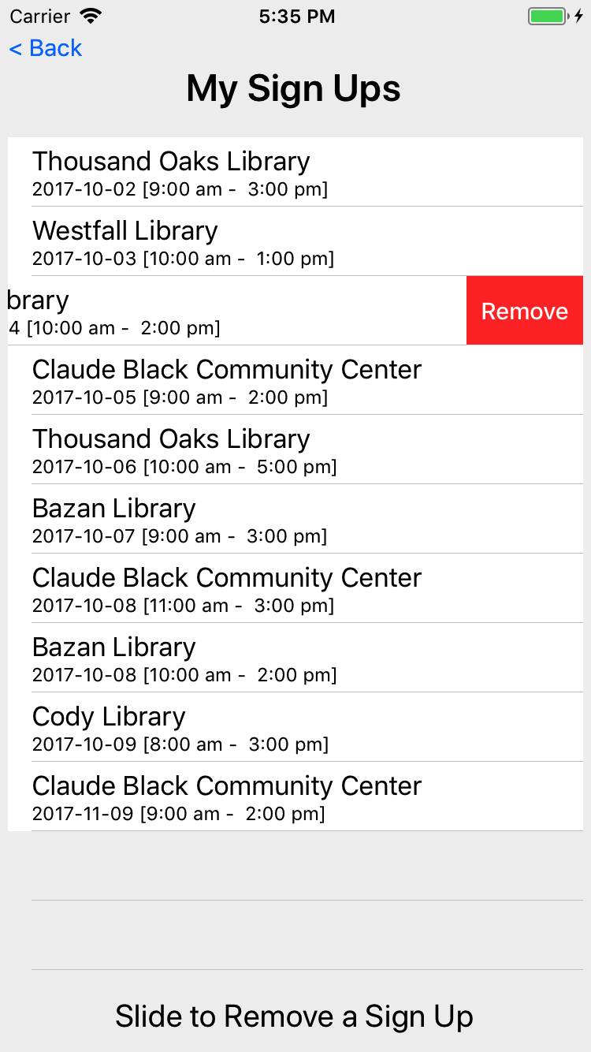
Review Signups – Remove
Slide to remove a signup
Does not remove from calendar

Slide 31
Review Signups - Details
View details of this signup
View other volunteers at same site on same date
Before shift end, set number of hours worked
Notes:
Here are the site details including directions.
Note the list of other volunteers for the site on that date.

Slide 32
Suggestions
Notes:
While logged in, you can view already posted suggestions or post a new suggestion

Slide 33
Suggestions - List
Use this to view suggestions already submitted by you (only)
Suggestions are reviewed by a volunteer review committee
Select Make a New Suggestion to create a new suggestion
Notes:
Suggestions can be viewed at any time but only changed prior to review by the review committee.

Slide 34
Suggestion – Create New
View an existing suggestion
Fill-in the fields to create a new suggestion
Select Save to submit
Suggestions may be deleted until reviewed by the committee
Notes:
For a new suggestion, fill in the required fields and save.
Previously saved suggestions can be edited until reviewed by the committee
We really do want to hear from you. Please let us know how we can improve

Slide 35
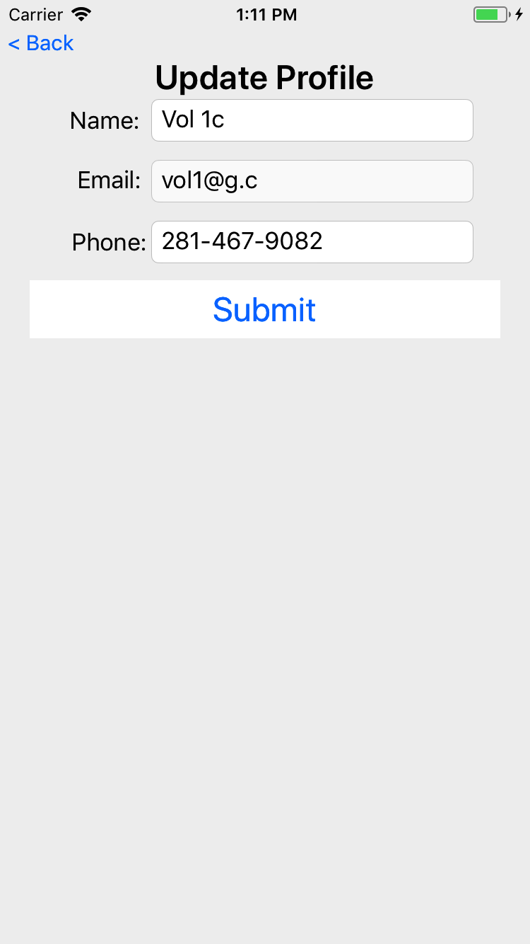
Update Profile
Allows changing of name, phone, and level of certification
Cannot change email
Select Submit to save the changes
Notes:
You can only change the display name and the phone number.
The certification can only be changed by the back office staff.

Slide 36
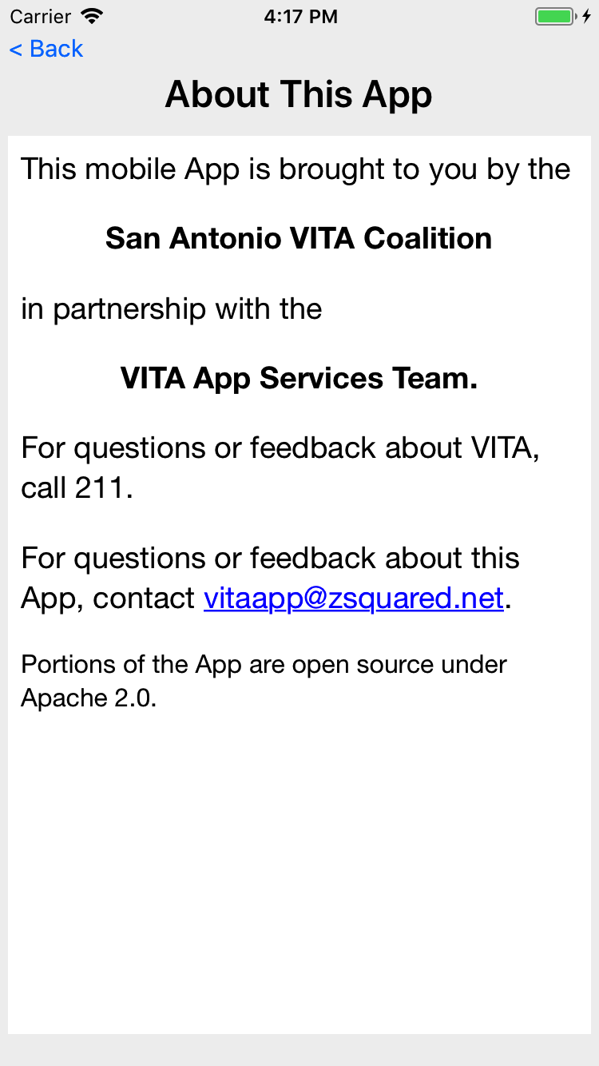
App About
Login not required
Contact the App support team using the email address on this page
Notes:
If you have suggestions or want to post an issue, please send me an email at vitaapp@zsquared.net

Slide 37
On Completed Certification
Download the app as soon as practical
Complete the registration and submit
When you have successfully completed the Certification (Basic or Advanced), take proof (13615) to the Catholic Charities representative at your training event.
The CC staff will verify certification and approve your registration and mark you as a volunteer
Immediately start signing up to volunteer at sites

Slide 38
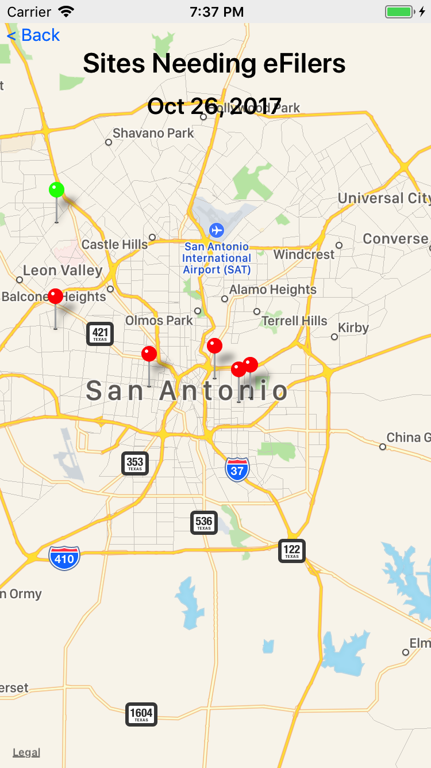
VITA SA App
Optimize the customer experience by fully utilizing staff, sites, and volunteers.
Encourage volunteers to go to the sites that need help.
(and away from sites that don’t)
Encourage clients to use the web and provide feedback.
Notes:
The app is a key part of improving the client and volunteer experience.
Please also encourage your clients to tell us how we did from the vitasa.org website.

